Slide 1

Business Data Management Capstone Project
“Optimizing Retail Performance: An Analysis of a Fashion Shop”
VIVEK KUMAR
ROLL NO. – 21F3000834
INDIAN INSTITUTE OF TECHNOLOGY, MADRAS

Slide 2


About the Project
Aims to identify the pertaining business problems
To develop solutions and recommendations
Focuses on three key areas: customer behaviour analysis, inventory management and sales data analysis
Its objectives:
Analysis of sales data
Analyse the shop’s revenue and expenditure data
Optimize inventory management

Slide 3

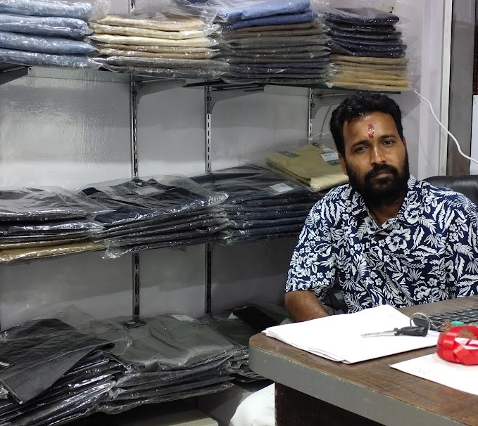

Business Overview
“The Flying Colors of Fashion”
Retail Garment shop
Model: B2C type of business
Started on Oct 2020, three years ago
Focuses on selling fashion-related products only for men
Shop mainly run by the owner
Location: Ranchi, Jharkhand

Slide 4
Methodology
Project Initiation
Data Collection
Data Analysis
Inferences and recommendations
Report and Presentation
I approached the owner of the shop and
Collected the data over a period of three months i.e Oct 2022 to Dec 2022.
The data contains sales data, revenue data, inventory data, and about the daily transactions and details of the customers.
Put the raw data in an Excel sheet in a structured way for further analysis.

Slide 5
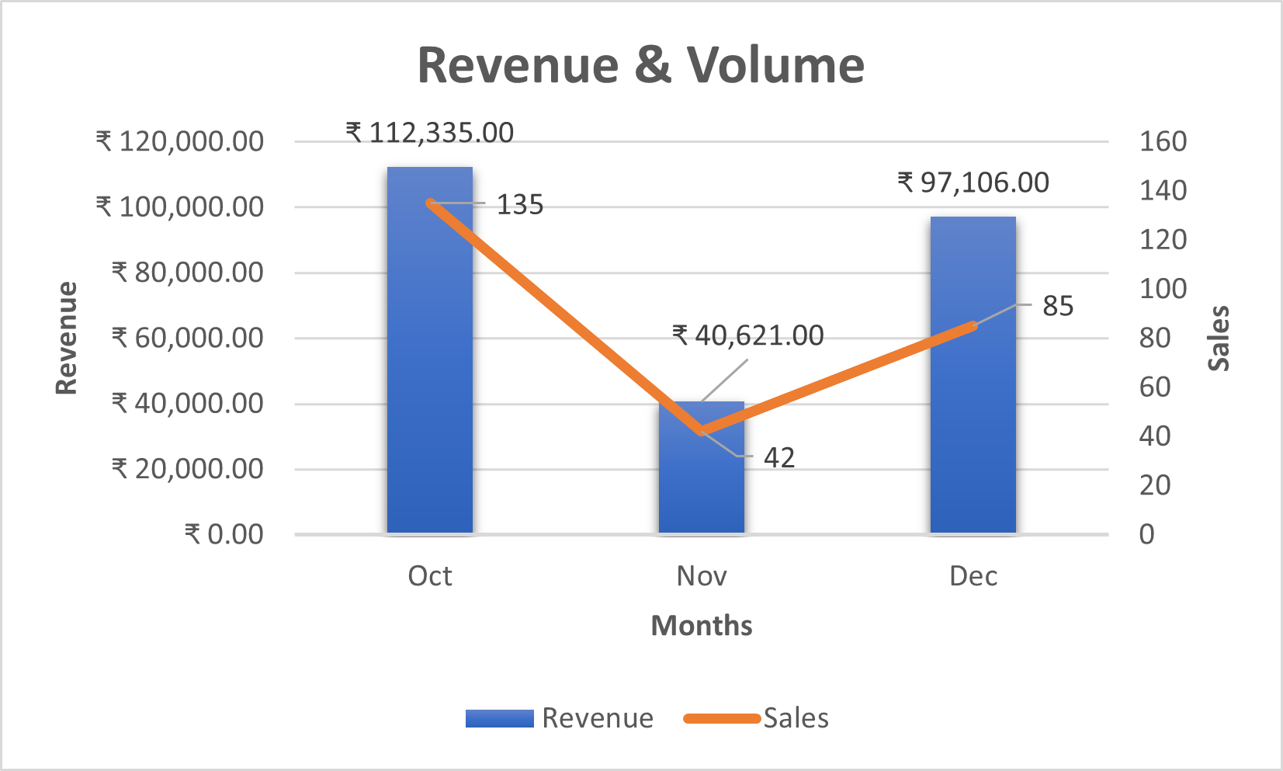
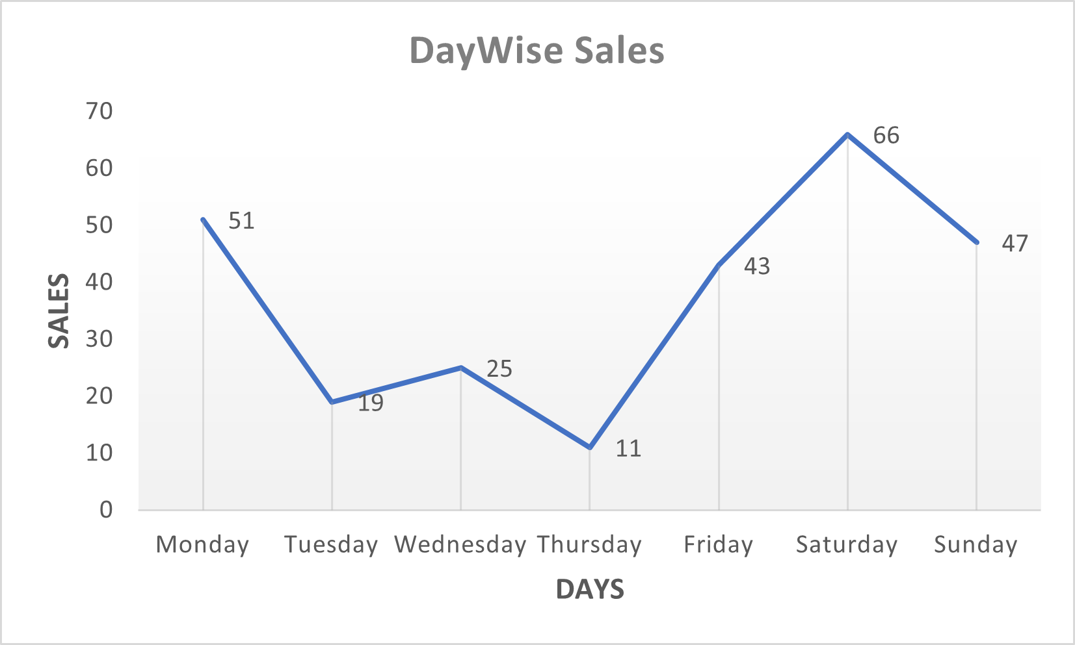
Sales Analysis

Slide 6
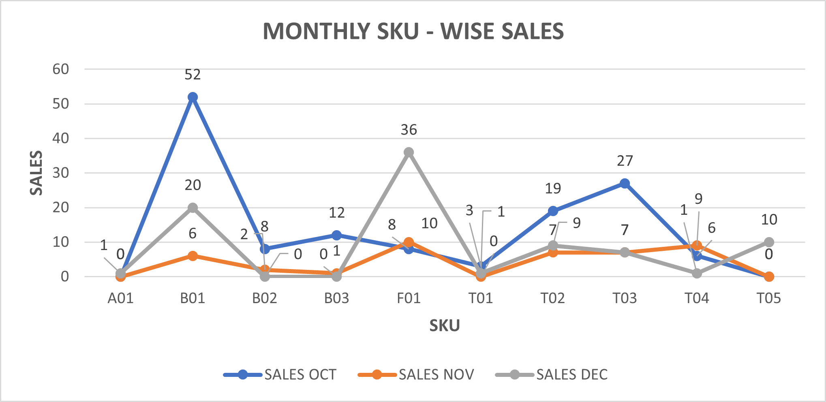
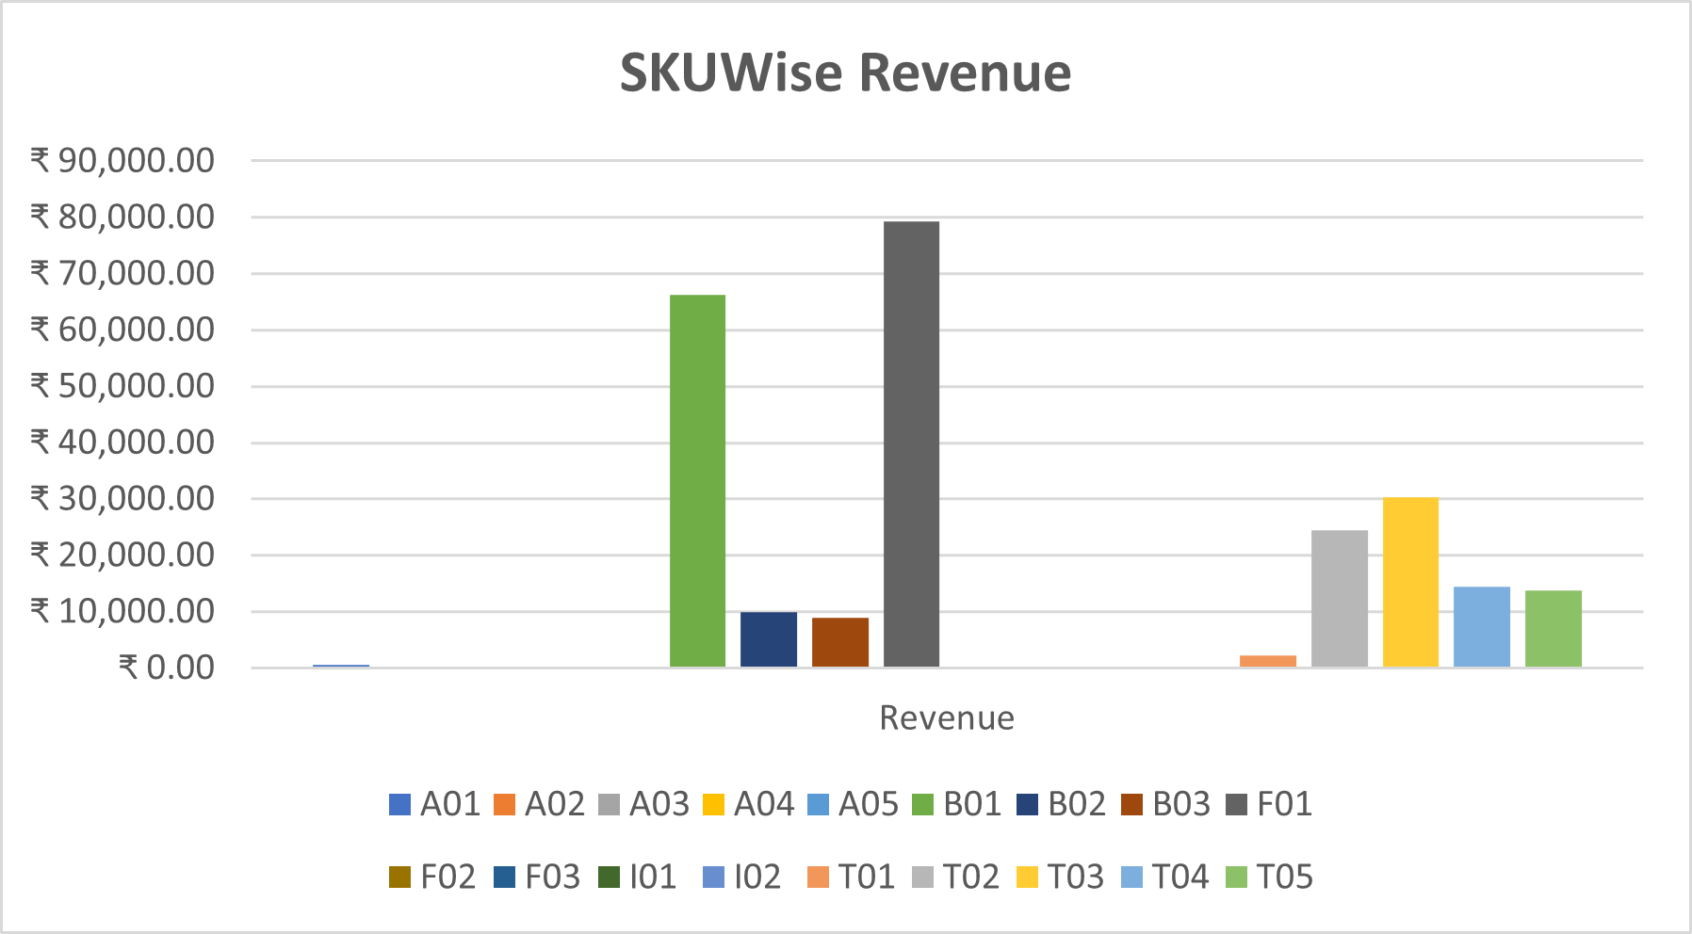
Sales Analysis…..

Slide 7
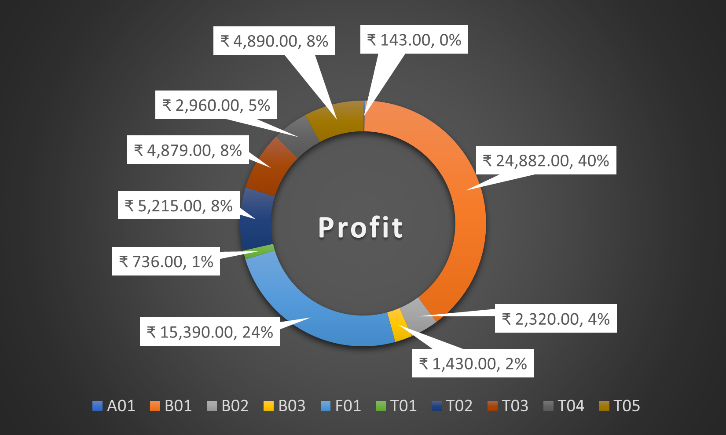
Financial Analysis
65% of the total profit just comes from only two products (B01 & F01).
Both contribute a profit of 40k collectively.
Other than these products, generally contribute about 2% to 8% of the total profit.

Slide 8
Interpretations and Recommendations
Interpretations:
Significant drop in sales during mid-week days (Tue, Wed, & Thu) and in the middle of the month.
The average purchase is relatively low about two thousand only over the months.
Out of 18 products, 8 are accessories with zero sales. The shop has fewer selling products
Out of 10 selling products, 2 (B01 & F01) are performing outstanding.
Investing more in certain products can maximize profits.
Recommendations:
Implement offers and promotions at mid-weekdays and mid-weeks of the month.
To increase the average order value, the shop could hire staff to cross-sell and upsell the products.
Improve shop and product visibility through offline & online signage/banners.
Reduce the stock of zero-sales products.
Diversify products with lower price ranges and expand its product offerings.

Slide 9
THANK YOU
VIVEK KUMAR
21F3000834
21f3000834@ds.study.iitm.ac.in

